Slide 1
June: Men’s Health Month
Presented by:
Louann Dent, RDN, LD
ldent@hy-vee.com

Slide 2
Men’s Health Week
Celebrated in the week leading up to and including Father’s Day.
Purpose:
Increase awareness of preventable health problems and encourage early detection and treatment of disease among men and boys.

Slide 3
Tips for men on how to take better care of themselves
Get Regular Check-ups.
If you cannot remember the last time you had a complete physical, call your doctor and make an appointment.

Slide 4
Pay Attention to Warning Signs
Changes in bowel or bladder habits.
Persistent backaches
Recurrent chest pains
Extreme fatigue
Need more information?
www.menshealthnetwork.org

Slide 5
Be more Physically Active
June is a great time to start a healthier lifestyle.
Aim for 30-60 minutes most days. You can even spread it out over the course of your day.

Slide 6
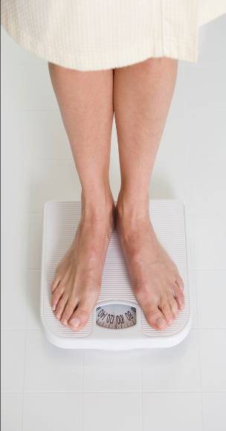
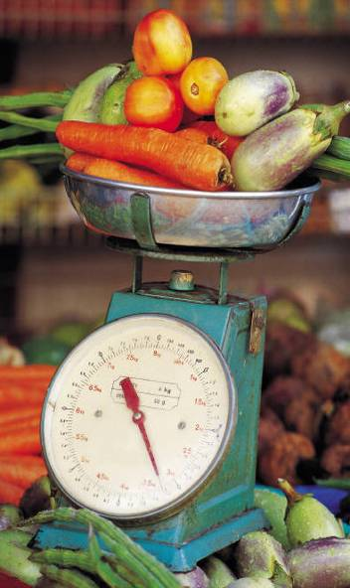
Physical activity and diet important regardless of weight!
Notes:
Attaining a desirable weight isn’t enough to be healthy if you didn’t following a healthy diet and physical activity to attain it.

Slide 7
“My idea of exercise is a good brisk sit.” ~ Phyllis Diller
Notes:
NOT!

Slide 8
Moderate aerobic activity increases breathing and heart rate somewhat
Notes:
Moderate activity is aerobic activity that increases a person’s breathing and heart rate somewhat. It includes brisk walking, dancing, swimming, or bicycling on a level terrain.

Slide 9
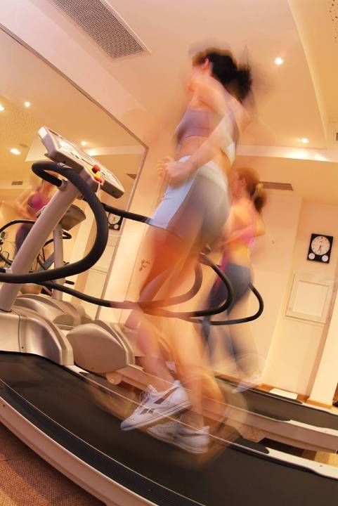
Vigorous aerobic activity greatly increases heart rate and breathing
Notes:
Examples of vigorous intensity activity that greatly increases a person’s heart rate and breathing include jogging, singles tennis, swimming continuous laps, or bicycling uphill.

Slide 10
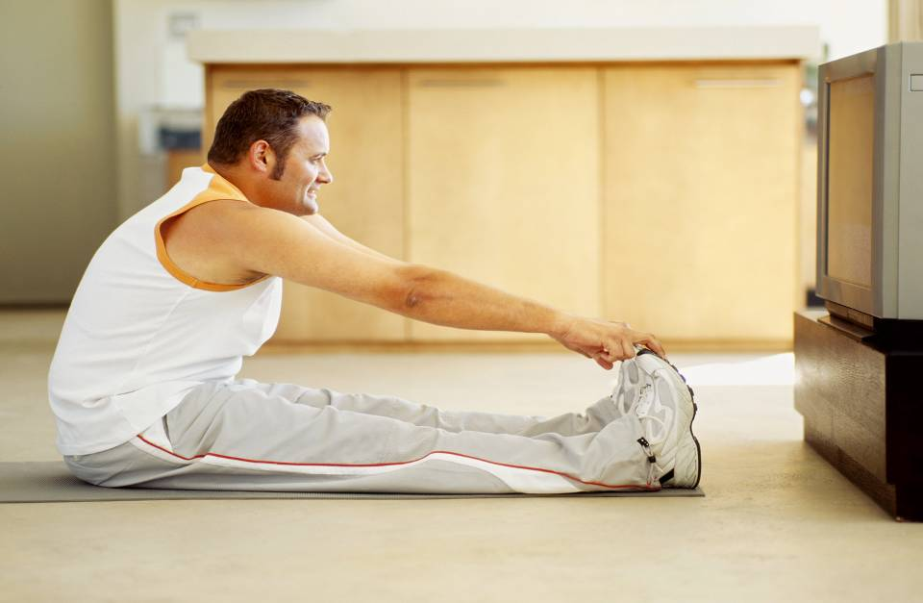
Limit screen time or
watch and workout
Notes:
Are there ways you can workout while you watch TV? Peddle on an exercise bicycle? Walk on a treadmill? Etc.

Slide 11
Short on time?
Get active
10 minutes
3 times a day
Notes:
Walk during a break, over the noon hour, while waiting for a load of laundry to get done, after dinner, etc.

Slide 12
Improve Your Diet
Variety, Moderation and Balance.
Rich in fruits, vegetables, whole grains & low-fat foods.

Slide 13
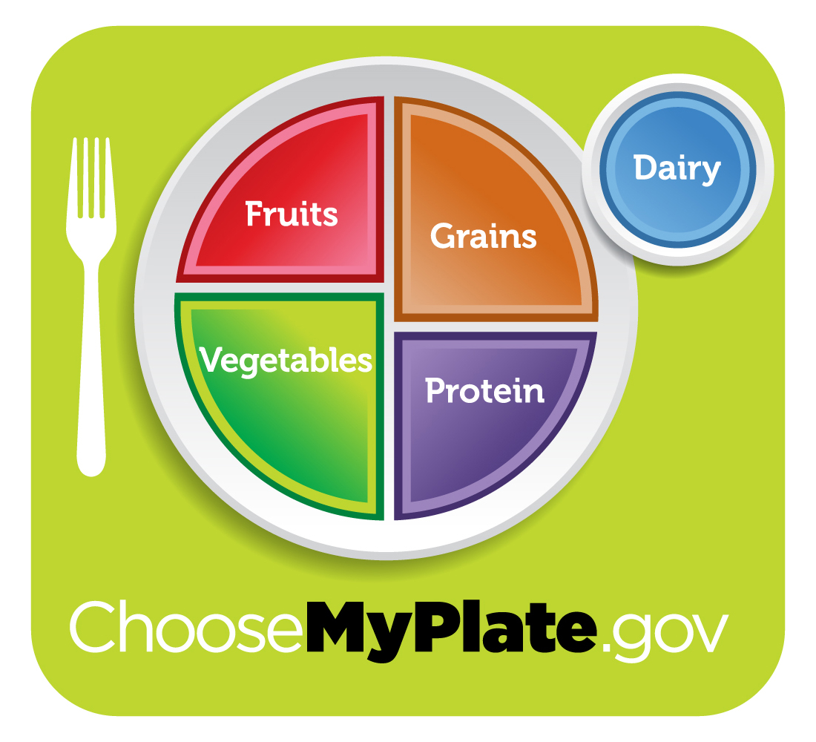
Choose MyPlate “Menu”
Foods to increase
Make half your plate fruits and vegetables
Make at least half your grains whole grains
Switch to fat-free or low-fat (1%) milk
Notes:
These are three main messages under “Foods to increase.”

Slide 14
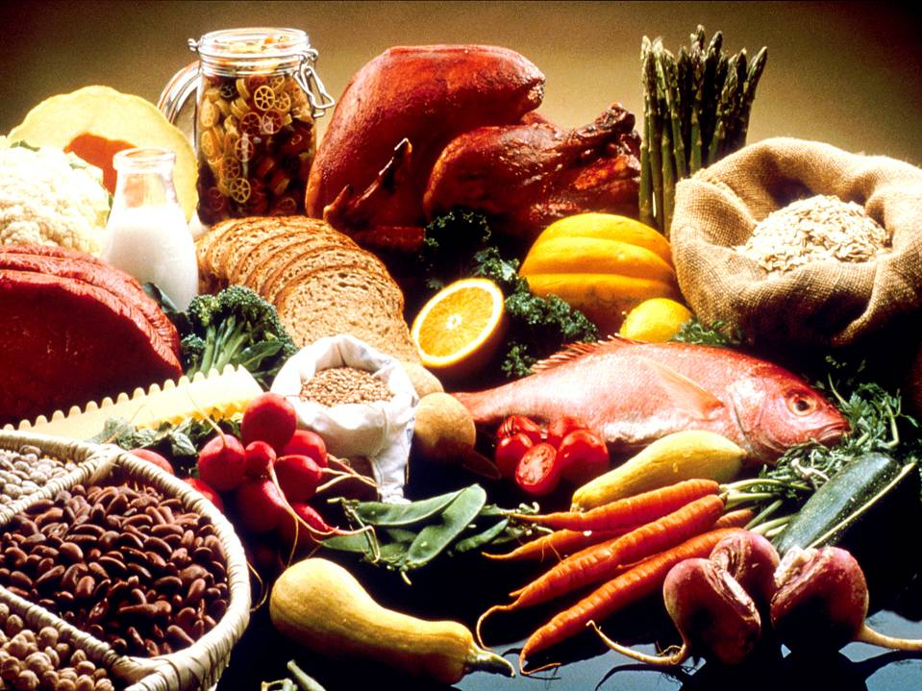
Eat more nutrient- dense foods
Photo courtesy of National Cancer Institute
14
Notes:
NOTE: This slide is for illustration purposes only. In real life, raw meat would not be placed next to foods that would be eaten uncooked.

Slide 15
Limit Saturated Fat
Found primarily in animal sources and are usually solid at room temperature.
Responsible for raising cholesterol levels.
Dietary sources:
Lard, meats, egg yolks, whole milk, sour cream shortening, salad dressings, whipping cream, chocolate, cheeses, ice cream, mayonnaise, butter, margarine, and coconut and palm oils.

Slide 16
What is Saturated Fats
Found primarily in animal sources and are usually solid at room temperature.
Responsible for raising cholesterol levels.
Dietary sources:
Lard, meats, egg yolks, whole milk, sour cream shortening, salad dressings, whipping cream, chocolate, cheeses, ice cream, mayonnaise, butter, margarine, and coconut and palm oils.
Notes:
Saturated fat –coconut oil and butter

Slide 17
Monounsaturated Fats
Thought to raise HDL (good) cholesterol and lower LDL (bad) cholesterol
Best dietary sources:
Canola, olive and peanut oils

Slide 18
Omega-3 Fatty Acids
Research has shown that this type of fat prevents blood platelets from “clumping” together and sticking to the artery walls
Helps prevent heart disease
Best dietary sources:
Flax, chia seeds or fish oils

Slide 19
Polyunsaturated Fats
Recent research suggests that polyunsaturated fats lower both HDL (good) and LDL (bad) cholesterol
Best dietary sources:
Safflower, sunflower, corn, soybean, and cottonseed oils

Slide 20
Trans Fatty Acids
Lab altered fat (not found in nature)
Ingredients: partially hydrogenated or hydrogenated oils
Found in baked goods, fast food fried foods, tortillas, crackers, cookies, other processed foods
Research has shown that trans fatty acids affect blood cholesterol much like saturated fats do.

Slide 21
Step Two: Know Your Numbers
 | Total Cholesterol | LDL Cholesterol | HDL Cholesterol | Triglycerides
Desirable | <200 mg/dl | <100 mg/dl | ≥ 60 mg/dl | <150 mg/dl
Borderline High | 200 – 239 mg/dl | 130 – 159 mg/dl | 40 – 59 mg/dl | 150 – 199 mg/dl
High Risk | ≥ 240 mg/dl | ≥ 160 mg/dl | ≥ 40 mg/dl | ≥ 200 mg/dl

Slide 22
Don’t forget Water
Water is one of the most important nutrients in your diet.

Slide 23
How Much is Enough?
Before exercise
Up to two hours before exercise, drink at
least 16 oz. of fluid
5 to 10 minutes before exercise, drink 4 - 8 oz. of fluid
During exercise
8 oz. of fluid every 15 - 20 minutes
After exercise
Drink 2 cups fluid for every pound lost

Slide 24
Questions?
Contact:
Louann Dent, RDN, LD
ldent@hy-vee.com
913-831-4447

