Slide 1
Staging Prostate Cancer
Finding the Right Treatment for You
Mark Scholz, MD
Prostate Cancer Research Institute
Culver City, California

Slide 2
Barriers to Optimal Prostate Cancer Treatment
Immensely broad spectrum of severity.
Doctors trained in one type of therapy.
The onus for choice resting with patients.

Slide 3
Staging
Learn one stage (not fifteen).
Find a pathway to optimal therapy.
Speak the doctor’s language
The risk of mets defines the stage.
Enables You to:

Slide 4
The Risk of Metastases Increases by Stage
SKY: Gleason 6, PSA < 10, DRE =small nodule or none.
TEAL: Gleason 7, PSA 10 - 20, DRE = “moderate” nodule on DRE.
AZURE: High-Risk, Gleason > 7 PSA>20, DRE = lg. nodule, seminal vesicle.
INDIGO: Locally relapsed, pelvic nodes, or a rising PSA after treatment. No bone, liver or lung mets.
ROYAL: Metastases beyond pelvic nodes and/or hormone resistance, a rising PSA with Testosterone < 50

Slide 5
What Are Cancer Metastases?
They consist of cancer cells growing in area of the body besides the prostate.
Clarification: Prostate cancer in the bones or liver is not the same as “bone” cancer or “liver” cancer.

Slide 6
How do Metastases Hurt You?
Metastases are the very essence of what makes cancer dangerous.
Enlarging metastases (tumors) lead to organ malfunction, leading to the failure of the bone marrow or the liver.

Slide 7
Micro-Metastases
Too small to be seen on scans.
Their presence can only be estimated by knowing the Stage.
When present, surgery or XRT to the prostate will not be curative.
Just as serious as visible mets. They can grow exponentially.
Are treatable with Lupron, Taxotere and XRT to pelvic nodes.

Slide 8
Why the Colors?
SKY TEAL AZURE INDIGO ROYAL

Slide 9
Six Questions Determine the Stage
1 What is the PSA 2 What is the Gleason score 3 Findings on digital rectal
4 Do scans show cancer outside the prostate 5 Is there a relapse after previous treatment
6 Is there a rising PSA on hormonal therapy

Slide 10
Take Our Online Quiz
To Find Your Stage
PCRI.org

Slide 11
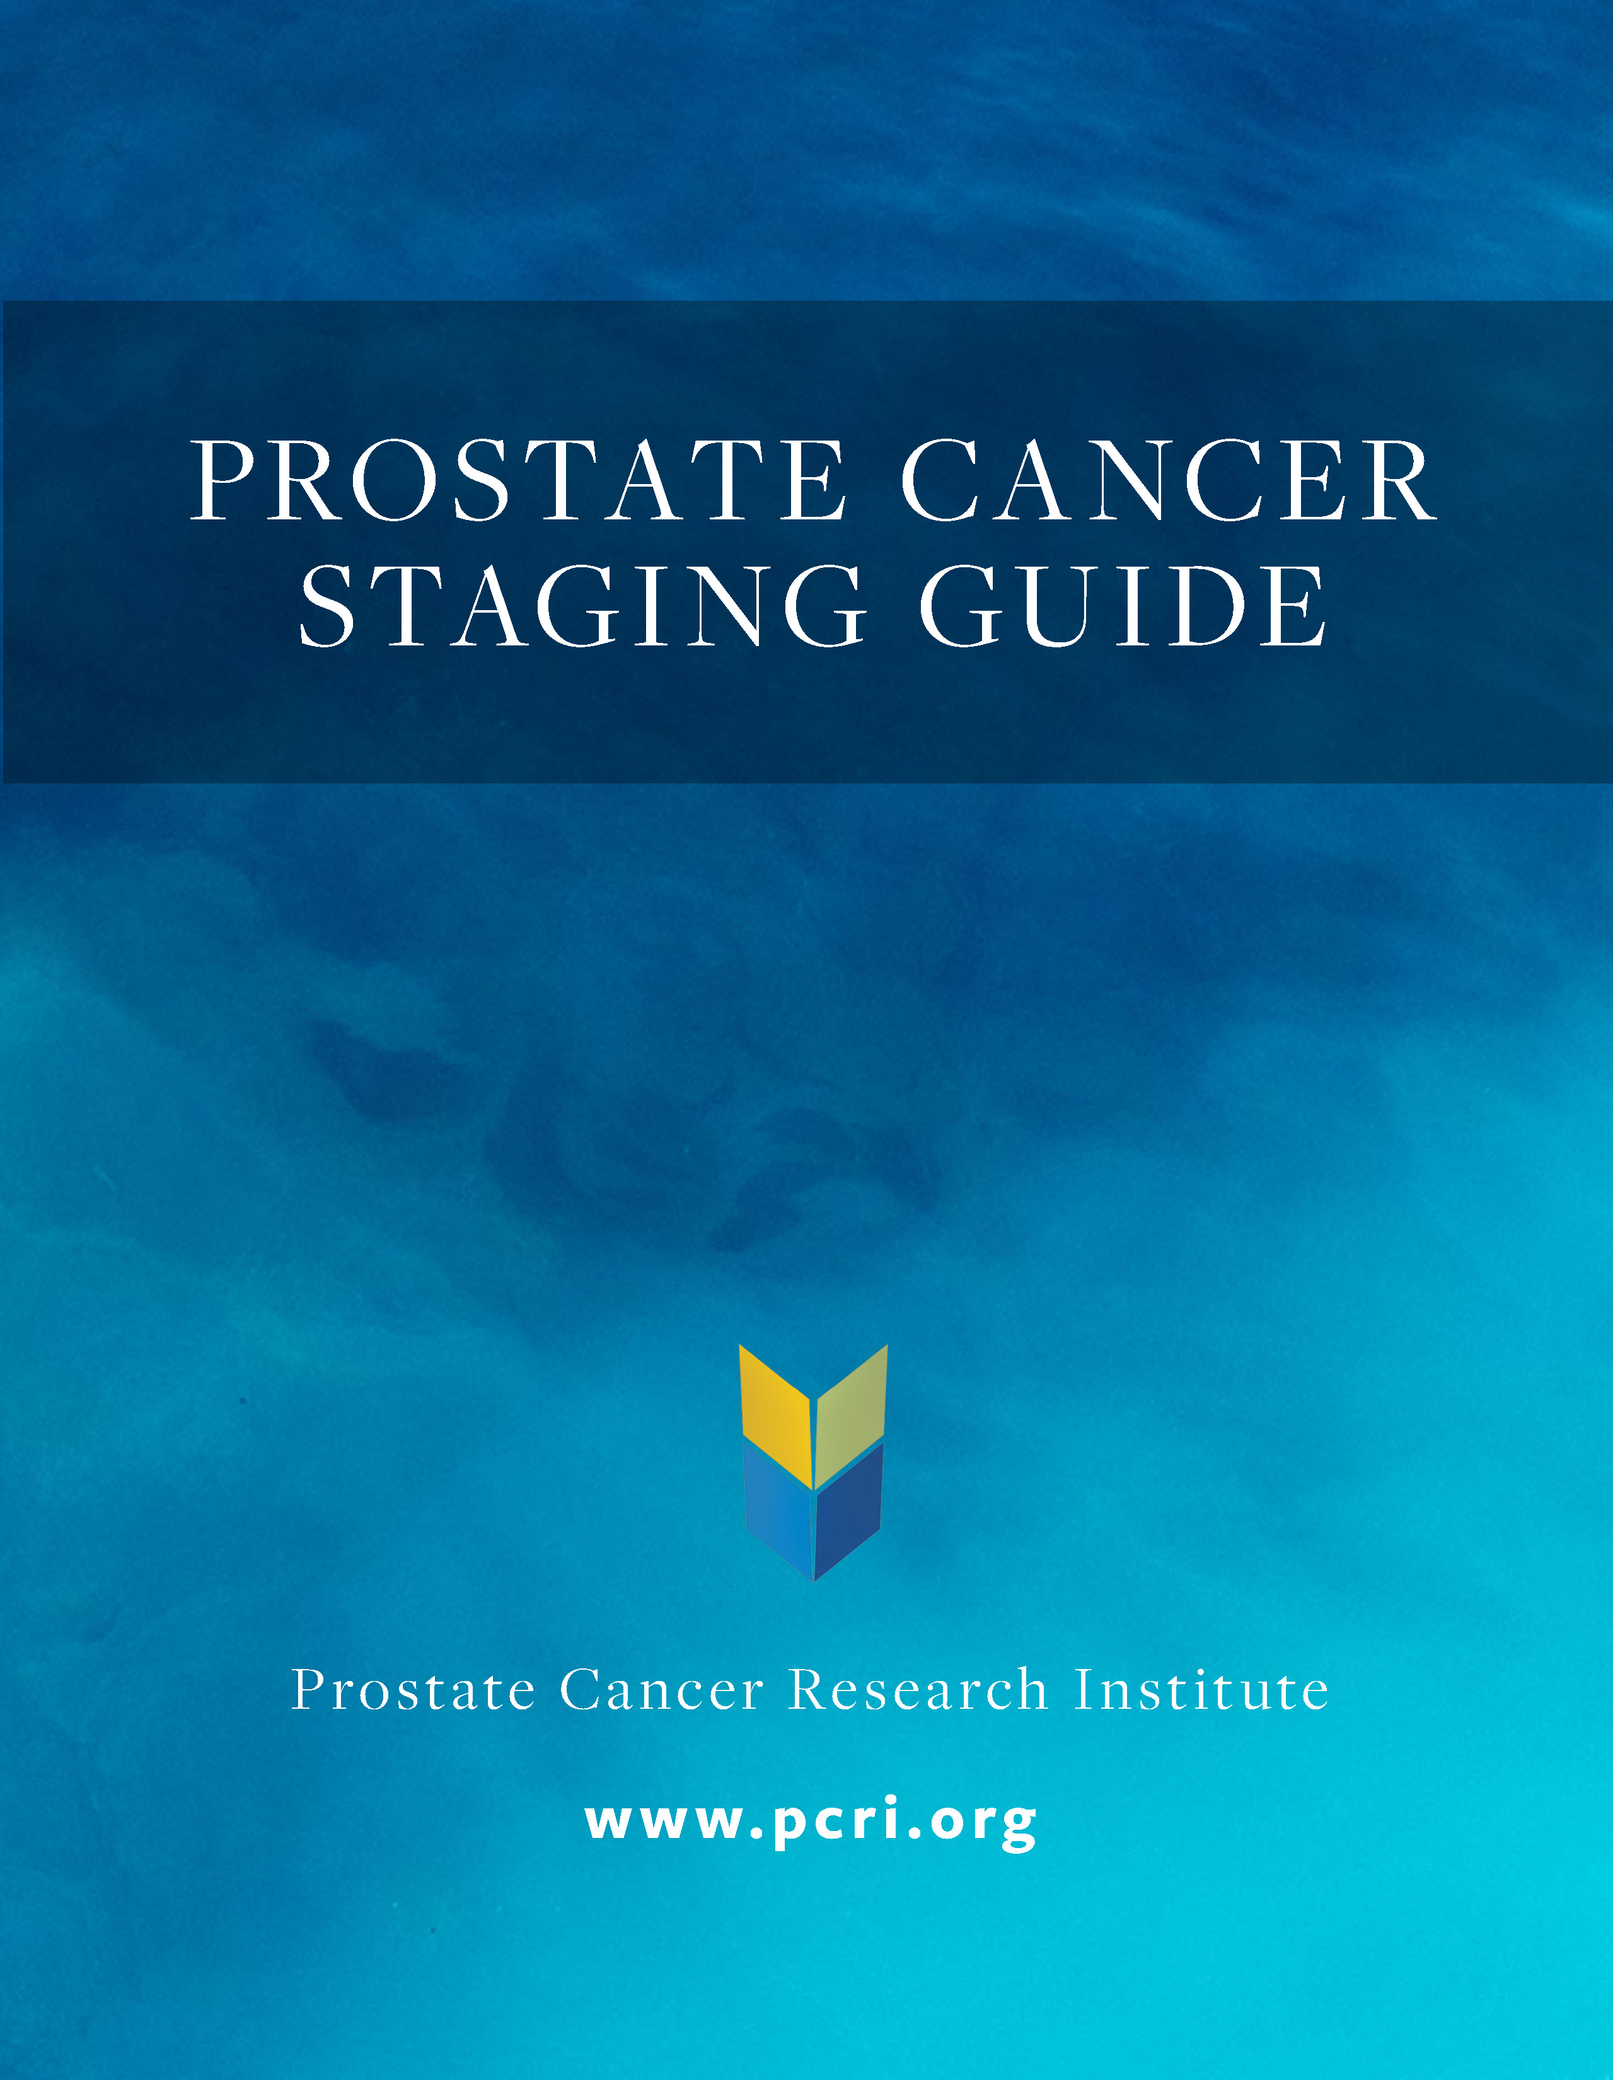
Once You Know Your Stage, Look Up Your Subgroup (Low, Basic vs. High)

Slide 12
Subgroups of SKY
Low: Only 2 or 3 cores with cancer.
No biopsy cores > 50% involved with cancer.
Basic: Everything between Low-SKY and High-SKY.
High: PSA density >0.15.
More than 50% of biopsy cores involved.

Slide 13
Treatments
Low:
Basic: Active Surveillance
High:
For SKY

Slide 14
Subgroups of TEAL
Low: All staging components are like SKY except:
Gleason 3+4=7 in < 50% of 1 or 2 cores.
The amount of Grade 4 must be < 20%.
Basic: Criteria neither fits Low-TEAL nor High-TEAL
High: Two or more intermediate-risk components.
Any Gleason 4 + 3 = 7.
> 50% of cores with Gleason 7

Slide 15
Treatment
Low: Active Surveillance
Basic: Seed implants
High: Seeds, IMRT & 4 mo. TIP
For TEAL

Slide 16
Subgroups of AZURE
Low: Only Gleason 8
Two or less biopsy cores
No biopsy core over 50% cancer.
PSA under 10 and small vol. dz. on MP-MRI.
Basic: Criteria that neither fits Low-AZURE nor High-AZURE
High: PSA over 40 or Gleason 9, 10 or > 50% of cores.
Cancer spread to seminal vesicles or nodes.

Slide 17
Treatments
Low: Seeds, IMRT, Short TIP
Basic: Seeds, IMRT, Long TIP
High: Same as Basic, plus Xtandi, Zytiga and possibly Taxotere.
For AZURE

Slide 18
Subgroups of INDIGO
Low: Disease prostate confined (or fossa).
Basic: Microscopic disease suspected in pelvic nodes.
High: Proven pelvic node metastases.

Slide 19
Subgroups of INDIGO
Possible Microscopic Metastases
Visible Metastases
LOW
BASIC
BASIC
HIGH
HIGH

Slide 20
Determining
What was the stage before surgery or XRT?
(SKY vs. TEAL vs. AZURE).
How high is your PSA now.
What is the PSA doubling time.
Results of PET scans: (Axumin, PSMA, C11,F18).
Your Subtype

Slide 21
These four questions determine the INDIGO subtype
Question 1: Have unequivocal pelvic lymph node metastases been detected? If the answer is “Yes,” your sub-type is High. If the answer is “no,” proceed to Question 2.
Question 2: Is the PSA over 0.5 (after surgery) or over 5.0 (after radiation)? If the answer is “Yes,” your sub-type is Basic. If the answer is “No,” proceed to Question 2.
Question 3: Is your PSA doubling time less than 8 months? If the answer is “Yes,” your sub-type is Basic. If “No,” proceed to Question 4.
Question 4: Was your original Stage (prior to surgery or radiation) Basic TEAL or higher? If the answer is “Yes,” your sub-type is Basic. If “No,” your sub-type is Low.

Slide 22
Treatment Options for INDIGO
Low: Radiation or salvage cryotherapy or
Intermittent hormonal therapy.
Basic: Radiation to the pelvic nodes plus
Hormonal therapy for 6 to 12 months.
High: Radiation to pelvic nodes plus
Zytiga or Xtandi and /or four to six cycles of Taxotere.

Slide 23
Subgroups of ROYAL
Low: Lupron-resistance, without mets outside the pelvic nodes
Basic: One to five mets.
High: More than five metastases.

Slide 24
Subtypes of ROYAL
Bone Mets
Nodes
Pelvic Node Region
LOW
BASIC
HIGH

Slide 25
ROYAL Subtyping
1. Do your body scans show the absence of metastases or mets limited to the pelvic nodes? If yes, your Stage is Low-ROYAL. If no go to question two:
2. Do your scans show one to five metastases? If yes, you are Basic-ROYAL. If you have more than five metastases you are High-ROYAL.

Slide 26
Low ROYAL
Search for metastases with scans.
If no metastases outside of the pelvic nodes are detected, start Erleada or Xtandi.
Treatment Approach

Slide 27
Basic-Royal: One to Five Mets
Testo < 50
Testo > 50 (No Previous Lupron)
Provenge for 6 weeks
SBRT to all sites of disease
Afterward, start Zytiga or Xtandi
Lupron (Firmagon, Eligard, Trelstar, etc.)
SBRT to all sites of disease
Zytiga or Taxotere

Slide 28
High-ROYAL: Over Five Metastases
Testo < 50
Testo > 50 (No Previous Lupron)
Provenge for 6 weeks
Start Zytiga or Xtandi
Consider adding Xofigo or Taxotere if PSA remains > 0.1 after 6 months
Lupron (Firmagon, Eligard, Trelstar)
Zytiga, Taxotere or both
Consider Provenge and Xofigo if PSA rises.

Slide 29
Back Up Treatments
Xofigo (radium 223).
Jevtana (cabazitaxel).
Carboplatin (with Jevtana or Taxotere).
Treatments selected by genetic testing.
Investigational therapy on clinical trial.

Slide 30
Your Staging & Treatment Resource

